Slide 1
BASIC MATHS FOR AI,ML
VIJAY RAJ

Slide 2

Equations
&
Functions
Derivatives
&
Optimization
Vectors
&
Matrices
Statistics
&
Probability

Slide 3
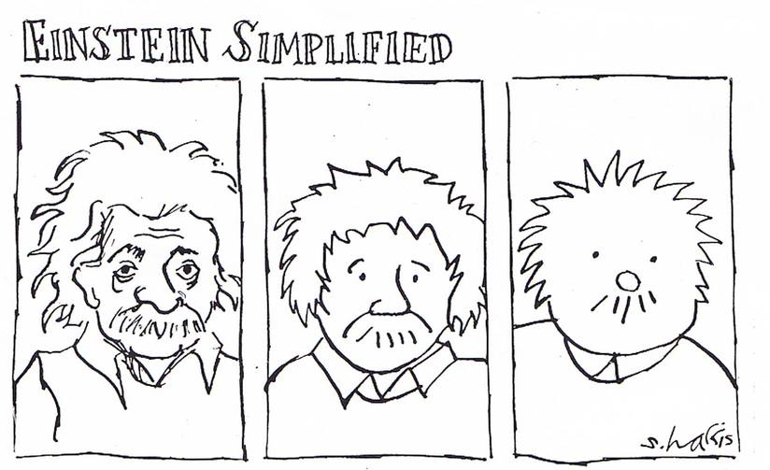

Slide 4
Machine learning is about predicting the future based on the past.
past
future
predict
learn
Training
Data
model/
predictor
Testing
Data
model/
predictor

Slide 5
DO YOU NEED TO BE REALLY GOOD
IN
MATHS ?

Slide 6
WHY WORRY ABOUT
MATHS ?

Slide 7
Choose right algorithms for the problem
Troubleshoot poor/ambiguous results
Recognize Under/over fitting
Make good choice on parameter setting ,validation strategies
Incorporating algorithms into more complex pipelines

Slide 8
STATISTICS
PROBABILITY
LINEAR
ALGEBRA
CALCULUS

Slide 9
STATISTICS
It’s the core of everything
Extract useful information from data
Compare / Interpret data

Slide 10
LINEAR ALGEBRA
Solve Simultaneous equations
Optimization Problem

Slide 11
2 y – 4 x = 2
2 y = 2 + 4 x
y = 1 + 2 x
x y
3
5
7

Slide 12
Slope m = dy
dx
m = y - y
2
1
x
(3,7)
x - x
2
1
(2,5)
m = 2
(1,3)
y

Slide 13
y = 1 + 2 x
y = 2 x + 1
y = m x + b
Slope intercept form of equation

Slide 14
Optimization
2
f(x) = 2 (x -2) + 2
What do you mean by optimizing this function ?

Slide 15
2
f(x) = 2 (x -2) + 2
2
= 2 x -8 x + 10
’
f(x) = 4 x - 8
4 x - 8 = 0
4 x = 8
x = 2
Is it a minimum , a maximum or just a inflexion point ?

Slide 16
f(x)
2
= 2 x -8 x + 10
’
’
f(x) = 4
The second order derivative is a constant
Since it’s a positive value we know that the slope is increasing as it crosses zero
So the optimum x value that minimize the function is 2
Then what is the minimum value ?

Slide 17
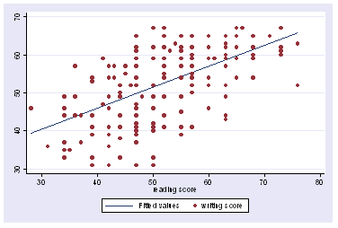

Slide 18
DERIVATIVES
Derivative of the function that represent a straight line
Derivative of the function that represent a curve

Slide 19
f(a) = 3a
a = 2 f(a) = 6
a = 2.001 f(a) = 6.003
Slope of f(a) at a= 2 is 3
slope= (height / width ) = (0.003/ 0.001)
a = 5 f(a) = 15
a = 5.001 f(a) = 15.003
Slope of f(a) at a= 5 is 3
d f(a) = 3
6.003
0.003
6
0.001
da
2
2.001
a

Slide 20
a = 2 f(a) = 4
a = 2.001 f(a) = 4.004001
Slope of f(a) at a= 2 is 4
slope= (height / width ) = (0.004/ 0.001)
a = 5 f(a) = 25
a = 5.001 f(a) = 25.01001
Slope of f(a) at a= 5 is 10
slope= (height / width ) = (0.01001/ 0.001)
d f(a) = d a = 2 * a
da da
2
f(a) = a
4.004001
4
2
2
2.001
a

Slide 21
Probability
What role do you think probability has to play in AI ?
Can you name a ML model out there based on probability ?

Slide 22
THANK YOU

